Slide 1

Lecture 1

Slide 2


Let us assume I am a Mafia Boss (Note: despite the accent this is not the case, but only hypothetical!) and I want to organize my gang.
Note that my organization is very Large, so there is quite a bit of things going on at any moment (i.e., many people accessing the database to record or read information).

Slide 3
I need to store information about:
People that work for me (soldiers, captain, etc...)
organizations I do business with (police, politicians)
completed and open operations:
  protection rackets
  arms smuggling
  drug smuggling
  loan sharking
  I need to avoid that any of my man is involved in burglary, mugging, kidnapping (too much police attention)
  money laundry and funds tracking
  assignment of soldiers to operations
  Etc...

Slide 4
The boss, under boss and captain should be able to access all the data and do any kind of operations (assign soldiers to operations, create or shutdown operations, pay cops, check the total state of money movements, etc...)
(20 of them) access to perform money book-keeping (track The accountants money laundering operations, move money from bank to bank, report bribing expenses)
The soldiers (5000) need to report daily misdeeds in a daily-log, and report money expenses and collections

Slide 5

As a first attempt, you think about just using a file system:
1. What to represent: what are the key entities in the real world I need to represent? How many details?
2. How to store data: maybe we can use just files: people.txt, organizations.txt, operations.txt, money.txt, and daily-log.txt. Each file contains a textual representation of the information with one item per line.

Slide 6
3. Control access credentials at low granularity(measure of level of detail): accountants should know about money movement, but not the names and addresses of our soldiers. Soldiers should know about operations, but not access money information
4. How to access data: we could write a separate procedural program opening
one or more files, scanning through them and reading/writing information in them.
5. Access patterns and performance: how to find shop we didn't collected money from for the longest time (and at least 1 month)? Scan the huge operation file, sort by time, pick the oldest, measure time? (Need to be timely or they will stop paying, and this get the boss mad... you surely don't want that, and make sure no one is accessing it right now).” Mosa ali" is a mole; we need to find all the operations and people he was involved or knew about and shut them down... quick... like REAL quick!!!

Slide 7
6. Atomicity: when accountant moves money from one place to another you need to guarantee that either money are removed from account A and added to account B, or nothing at all happens... (You do not want to have money vanishing, unless you plan to vanish too!).
7. Consistency: guarantee that the data are always in a valid state (e.g., there are no two operations with the same name)
8. Isolation: multiple soldiers need to add to daily-log.txt at the same time (risk is that they override each other work, and someone get fired" because not productive!!)
9. Durability: in case of a computer crash we need to make sure we don't lose any data, nor that data get scrambled (e.g., If the system says the payment of a cop went through, we must guarantee that after reboot the operation will be present in the system and completed. The risk is police taking down our operation!)

Slide 8
Using the file system, you realize that most probably you will fail, and that can be very dangerous... Luckily you are enrolled in course of database systems and you just learned that: Databases address all of these issues!! You might have a chance! Three concepts of database systems helps to solve these issues:
1-3 are problems related to Data Model
4-5 are problems related to the Query language and
6-9 are problems related to Transactions.

Slide 9
So let's try to do the same with a “database" and get the boss what he needs

Slide 10
Fundamental concepts of Databases:
From database theory we will investigate few key concepts here:
Data Model: Defines in which manner data can be stored, organized and manipulated in DBMS.
The most popular example is relational data model. A relation is a table with rows and columns. Columns of a relation are called attributes and set of values the attributes are allowed are called domains.

Slide 11
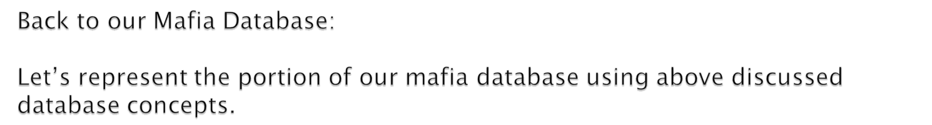
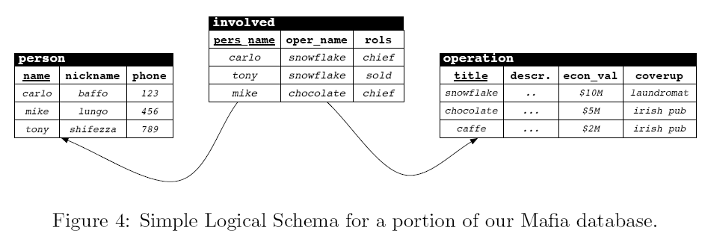

Slide 12

Query Language: DBMS provide high level query language to describe:
Operations on database. For example access, update, delete, insert etc.
The goal is to guarantee data independence (logical and physical) by separating what you want to do with data from how to achieve that. More later.
Optimization techniques for efficiently accessing data.
Transactions:
A way to group actions that must happen atomically (all or nothing)
Guarantees to move the DB content from a consistent state to another isolate from parallel execution of other actions/transactions
Recoverable in case of failure (e.g., power goes out)

Slide 13
Back to our Mafia Database

Slide 14
Accessing data transitionally:
Let’s consider the following operations you want to do on data, and how we can represent them using the standard relational query language SQL:
Which operations involve “Tony Schifezza”?
SELECT oper_name
FROM involved
WHERE person = "tony";

Slide 15
Reassign Tony’s operations to Sam and remove Tony from the database (he was the mole).
BEGIN
UPDATE involved i SET pers_name="sam" WHERE pers_name="tony";
DELETE FROM person WHERE name = "tony";
COMMIT

Slide 16
Create a new operation with “Sam Astuto” in charge of it.
BEGIN
INSERT INTO operation VALUES (’newop1’,’’,0,’Sam’s bakery’);
INSERT INTO involve VALUES (’newop1’,’sam’,’chief’);
COMMIT

Slide 17
Recommended Readings:
Chapter 1 of Ramakrishnan, Raghu, and Johannes Gehrke. Database Management Systems.
Chapter 1 of . Silberchatz, Korth, Sudarshan. Database System Concept

Slide 18

Introduction to Databases
The Relational Model
Background to SQL Querying and programming commands and syntax
Normalization and other basic design issues
Join Algorithms
Programmable Objects
Transactions and concurrency
Indexing and access methods
1A-<number>

Slide 19

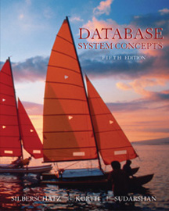
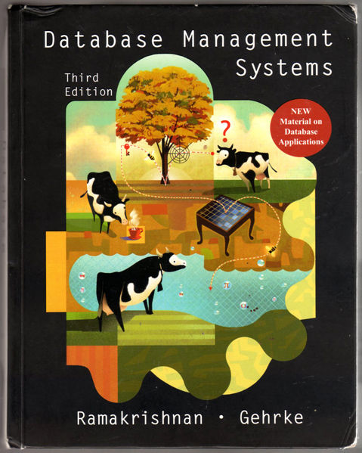
1A-<number>

Slide 20

3 quizzes (announced/un announced) 10%
(there would be 1 makeup quiz only for those students who have missed their quiz)
2 Assignments 10%
OHT-1 15%
OHT-2 15%
Final Exam 50%
1A-<number>

Slide 21

1A-<number>

